Slide 1
E-16 Wurzbach Parkway Sewer at Highway 281
Patrick O’Connor, PE
Project Engineer, SAWS
Roxanne L. Lockhart
Contract Administrator, SAWS
Marisol V. Robles
SMWVP Program Manager, SAWS
Mario Valdez, PE
Project Engineer of Record, KHA
Jeff Farnsworth, PE
Project Engineer, KHA
Non-Mandatory Pre-Proposal Meeting
May 18, 2020 at 2:30 PM

Slide 2
Oral Statements
Oral statements or discussion during the pre-proposal meeting will not be binding, nor will it change or affect the terms or conditions within the Plans and Specifications for this Project. Changes, if any, will be addressed only via an Addendum.

Slide 3
Meeting Agenda
Project Overview
Contract Requirements
Evaluation Process
Required Experience
Evaluation Criteria
SMWVB
Proposal Packet Preparation
Additional and Communication Reminders
Key Dates
Contract Background
  Special Provisions
  Special Specifications
  Supplemental Conditions
  Special Conditions
Additional Project Information
Questions

Slide 4
Project Overview
Construction of 24, 27, 36, and 78-inch gravity sanitary sewer pipeline at depths of up to 29 feet via open cut or tunneling installation methods.
Construction of 2,300 LF of 6”-8” DI water line
Challenges
  EPA Consent Decree
  Installation of gravity sewer within the 100-year floodplain and City of San Antonio Parks Property.
  Open-cut installation of 78-inch gravity sewer along narrow right-of-way (North Loop Rd) at depths over 25-feet. Overhead electric in close proximity.
  Geotechnical Site Conditions
  Limited Access
  In-line Storage Structures
  Tunneling under existing sewer main at N Loop Road creek crossing

Slide 5
Non-Mandatory Pre-Proposal Meeting
Key project information:
  730 calendar days
  Construction estimate is approximately $16.3M
  Procured under Chapter 2269 of Texas Government Code as a Request for Competitive Sealed Proposals (RFCSP)
  EPA consent decree project, which requires additional reporting and retention of document (see Special Conditions)

Slide 6
Contract Requirements
  Prevailing Wage Rate and Labor Standards – Section 2.10 of the General Conditions
  Certified payroll to be submitted on weekly basis
  Wage decisions are included within the specifications
  Contractors to utilize LCP Tracker
  Site visits are random and unannounced
  Interviews will be conducted and will be private & confidential
  Payroll records are subject to review
  All apprenticeship programs will need to be approved by Department of Labor prior to starting
  Contractors are responsible for sub-contractor payroll
  Late payrolls delay contractor payments from SAWS

Slide 7
Contract Requirements (cont.)
Insurance – Found in Section 5.7 of the General Conditions
  Include General Liability for Construction, Pollution Liability, Excess Liability and Installation Floater (in lieu of Builder’s Risk).
  Selected contractor must be compliant with all other contracts in order for SAWS to award the contract.
  SAWS will request insurance certificate prior to Board award to ensure insurance compliance and expedite execution of the contract.
  Insurance must be compliant prior to executing the contract.

Slide 8
Evaluation Process
  Technical Evaluation Committee (TEC) will score the proposals based on the evaluation criteria published in the Supplementary Instructions to Respondents to determine the Respondent who can provide the best value to SAWS
  Price will be calculated (lowest price receives the highest points) and added to final scores
  SMWVB will be added to final scores
  Selection Evaluation Committee reviews final scores
  Negotiations, if any
  Board award

Slide 9
Required Experience
Large diameter wastewater pipe installation is primary business focus and service, such services successful for at a minimum of 5 continuous years
  Installing large diameter 54-inch and larger gravity sanitary sewer pipeline at depths > 25 ft. via open cut or trenchless
  Installing sewer pipelines in narrow corridors along creek ways
  Complex sequencing across multiples sites within the same project
  Managing bypass pumping of large flows (10 MGD or >)
  *See page SIR-2 of the SIR for full details

Slide 10
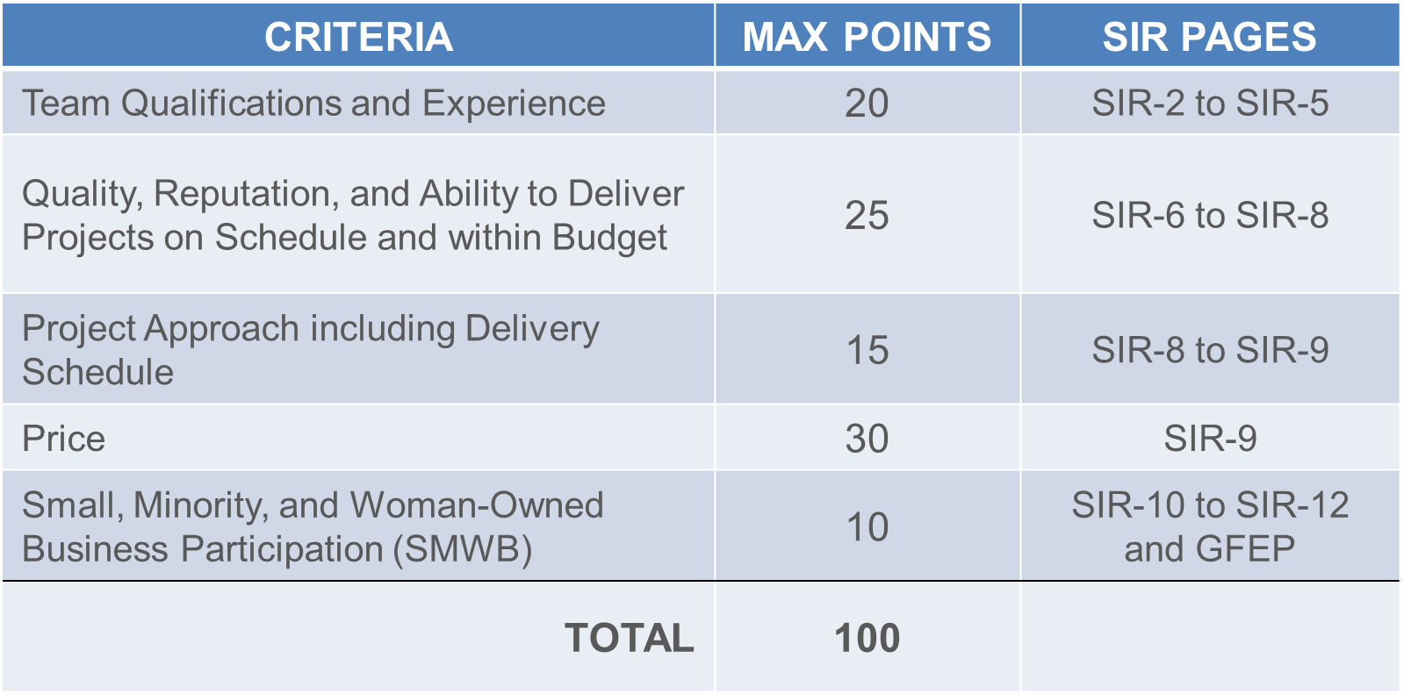
Evaluation Criteria
SIR-10

Slide 11
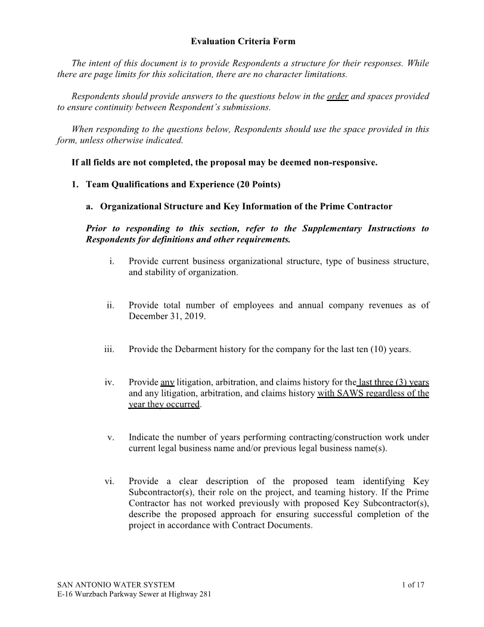
Evaluation Criteria
Evaluation Criteria Response Form

Slide 12
Evaluation Criteria
Team Qualifications and Experience (20 points)
Organizational Structure and Key Information on Prime Contractor
  Company information (structure, debarment history, # of employees, years of construction work, etc.)
  Organizational Chart with Key Personnel with percentage of availability, clear description of roles and responsibilities (Prime and Key Subs)
    Team history or approach if no prior experience to ensure successful completion of project
  Financial statement within the last 12 months by independent CPA
  Contractor CANNOT change key personnel identified in proposal without written request to SAWS and SAWS written approval
* Refer to SIR for full detail of Evaluation Criteria requirements

Slide 13
Evaluation Criteria
Team Qualifications and Experience (cont.)
Qualifications and Experience of Key Personnel Proposed for Project
  Resumes of Key Personnel on 8 ½ x 11” one per person, not to exceed one (1) page as identified on the Org Chart
    Professional experience, education, role, descriptions of capabilities, etc.
    List of all other active projects team member assigned, percentage, date of completion of work
✓ Key Personnel include PM, CM, QA/QC Lead, Project Scheduler, Project Superintendent, Open Cut Superintendent, Pipe Jacking/Tunneling Superintendent
✓ Key Subcontractor roles include tunneling, hand mining, large diameter open cut, sewer bypass.

Slide 14
Evaluation Criteria
Quality, Reputation and Ability to Deliver Projects on Schedule and within Budget (25 points)
Prime Contractor On-Time Completion on Similar Projects in the past 10 years
  List and describe 5 completed projects of similar size, scope, and complexity within the last 10 years
  Owner reference contact information should be valid and recently verified
    If valid contact information is not provided, score or proposal may be negatively impacted
  2 of the 5 projects listed must have been performed by the proposed Key Personnel
  If SAWS experience, one project of similar size, scope, and complexity must be included
  The Respondent shall provide information for all current and recently completed large diameter pipeline projects performed in the last five (5) years for all Utility Owners in Texas
* Refer to SIR for full detail of Evaluation Criteria requirements

Slide 15
Evaluation Criteria
Quality, Reputation and Ability to Deliver Projects on Schedule and within Budget
Key Subcontractor(s) Performance on Similar Projects in the Last 10 years
  Provide list of 2 projects that Key Subcontractors Project Manager and/or Superintendent participated in of similar size, scope, and complexity
  If Prime plans to self-perform and has no Key Subcontractors, provide a list of 2 additional projects
    Key Personnel shall have participated in at least 1 of the 2 projects
* Refer to SIR for full detail of Evaluation Criteria requirements

Slide 16
Evaluation Criteria
Project Approach including Delivery Schedule (15 points)
Project Approach
  Narrative of Project Approach to complete project, including key milestones, critical path items, phases and/or sequencing, permits, etc.
  Availability of equipment and facilities
  Describe approach for coordination with key stakeholders
  Provide innovative ideas for cost savings (due to method or duration)
  Quality Management Plan including subcontractor oversight, QA/QC, etc.
Project Schedule, procurement of long-lead items, unforeseen conditions (5 points)
  Critical path method (CPM) schedule Primavera or Microsoft project - Assume NTP of August 24, 2020
  Project approach to procure long-lead items
  List and describe prior instances of unforeseen conditions
  Approach for mitigating and managing unforeseen conditions on this project
* Refer to SIR for full detail of Evaluation Criteria requirements

Slide 17
Evaluation Criteria
Safety Information for Prime Contractor and Key Subcontractor(s) (Pass/Fail)
Records showing Total Recordable Incident Rate (TRIR) past 5 years
Provide records showing the company’s Experience Modification Rate (EMR) past 3 years
List fatalities in company’s safety history for Prime Contractor and Key Subcontractor(s)

Slide 18
Evaluation Criteria
Price (30 points)
Lowest total price will receive 30 points.
Remaining proposals will receive points based on comparison to the lowest price proposal.
Small Minority, Women, and Veteran-owned Businesses (10 points)
As indicated on the Good Faith Effort Plan
* Refer to SIR for full detail of Evaluation Criteria requirements

Slide 19
Evaluation Criteria
Industry | SMWB Goal
Construction | 20%

Slide 20
SMWVB Scoring
Proposed SAWS Construction Alternative Delivery Method SMWB Scoring:
The maximum number of SMWB points to be earned is 10 points. Firms may use any combination of points below when attempting to meet the SMWB goals. Self-performance and subcontracting may be used to achieve the aspirational goals and earn points. SMWB prime contractors and/or subcontractors must be certified by the South Central Texas Regional Certification Agency, and must have a local presence in the San Antonio Metropolitan Statistical Area in order to be counted for SMWB points. All prime contractors firms, whether SMWB or not, are eligible to earn the maximum number of SMWB points (10).
1. M/WBE Scoring Method: 10 Points (By percentage) 20.00% M/WBE Goal
• MBE Participation Percentage between 1% and 4.99%: 1 Point
• MBE Participation Percentage between 5% and 9.99%: 2 Points
• MBE Participation Percentage between 10% and 14.99%: 4 Points
• MBE Participation Percentage between 15% and 16.99%: 5 Points
• MBE Participation Percentage between 17% and 19.99%: 8 Points
• MBE Participation Percentage meeting or exceeding 20.00%: 10 Points
2. SBE (Non-M/WBE) Scoring Method: 5 Points (By percentage) 5% SBE Goal
• SBE Participation Percentage between 1% and 1.99%: 1 Point
• SBE Participation Percentage between 2% and 2.99%: 2 Points
• SBE Participation Percentage between 3% and 3.99%: 3 Points
• SBE Participation Percentage between 4% and 4.99%: 4 Points
• SBE Participation Percentage meeting or exceeding 5.00%: 5 Points

Slide 21
Accepted SMWVB Certification Agency
South Central Texas Regional Certification Agency
(Includes the Texas Historically Underutilized Business “HUB” Program)
Minimum Qualifications for SMWVB recognition:
SBE-Certified (even MBEs and WBEs)
Local office or local equipment yard

Slide 22
Accepted SMWVB Certifications
Minority Business Enterprise (MBE) (Includes AABE, ABE, HABE and NABE)
Small Business Enterprise (SBE)
Woman-owned Business Enterprise (WBE)
Veteran-owned Business Enterprise (Tracked, but not eligible for points)

Slide 23
Good Faith Effort Plan (GFEP) FAQs
Q: Is the 20% SMWVB goal mandatory?
A: No, but we ask prime contractors to do their best with good faith outreach efforts. If the goal is not met, proof of outreach efforts is required with the submittal.
Q: What if I am having trouble finding SMWVB subcontractors?
A: Please email the SMWVB Program Manager with the scopes of work you are seeking. You will receive lists of local SMWVB-certified firms to contact.
Q: What if my business is SMWVB-certified? Do I need to find SMWVB subs?
A: If your firm is SMWVB-certified, you will most likely meet the goal. However, the GFEP is a required document, and a good faith outreach effort is still necessary.
Q: Do I need to include all my subcontractors in the GFEP or just those that qualify towards the
SMWVB goal?
A: All subcontractors need to be included in the GFEP, even those that may not count towards the SMWVB goal.
Q: What if I have questions about the GFEP?
A: Please contact the SMWVB Program Manager at 210-233-3420, or at Marisol.Robles@saws.org . GFEP questions can be asked at any time before the submittal is due.
Notes:
SMWB

Slide 24
Post Award: Subcontractor Payment & Utilization Reporting (S.P.U.R.) System
1. Subcontractor & Supplier Payment Tracking
2. Subcontractor and Supplier Additions or Substitutions
3. LCP Tracker
4. Must be Current and Accurate before Retainage is released https://saws.smwbe.com

Slide 25
Proposal Packet Preparation
Review Instructions to Respondents and Supplementary Instructions to Respondents
Utilize the Proposal Response Checklist
  Original proposal (1) and USB flash drive, along with required information differs from copies (7)
  Include Financial Statement
Thoroughly review scope and ensure project examples and key personnel resumes clearly show similar experience
Thoroughly review evaluation criteria and respond with all required information to maximize points
  Using the Evaluation Criteria form
Avoid “boilerplate” responses

Slide 26
Proposal Packet Preparation (cont.)
Verify contact information for all project references, if SAWS is not able to contact reference, points may be deducted or proposal deemed non-responsive
Ensure required documents are submitted and signed, (i.e. Respondent Questionnaire, CIQ, etc.)
Baseline schedule
Entire proposal should create a clear picture of Project Team experience and capabilities (Org chart, projects, and resumes for Key Personnel and Key Subcontractors)
Price Proposal
  Acknowledge Addendums on Proposal Signature Page
  Verify extensions and mob and prep of ROW percentages

Slide 27
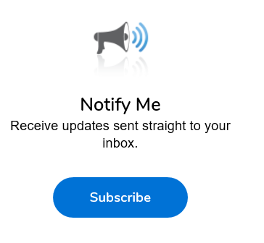
Additional Reminders
Register with Vendor Registration Program on the SAWS website at www.saws.org to ensure access to the latest information.
To receive updates on specific projects, registered vendors should subscribe to the project by selecting the project, and clicking ‘Subscribe’ under the Notify Me box.
Notes:
Contracting

Slide 28
Communication Reminders
There shall not be any communication with the following during the Proposal period:
  Design Engineer (Kimley-Horn)
  SAWS Project Manager or Project Engineer
  Any other SAWS staff
  City Council member or staff
  SAWS Board of Trustees
This includes phone calls, emails, letters, or any direct or indirect discussion of the Proposal

Slide 29
Key Dates
May 18, 2020 Non-Mandatory Pre-Proposal Meeting
May 27, 2020 by 2:00 PM Questions Due
June 2, 2020 by 5:00 PM Addendum Posted to SAWS Website
June 17, 2020 by 2:00 PM Proposals Due
June 2020 Proposals Evaluated
July 2020 Selected Contractor Notified
August 4, 2020 SAWS Board Approval and Award
August 24, 2020 NTP Issued

Slide 30
Submission Due Date
Proposals due no later than 2:00 PM CDT June 17, 2020
Follow specific delivery instructions:
  Deliver to 2800 U.S. Highway 281 North, Suite 171, Customer Service Building, Counter Services (across from the guard station)
  Make arrangements if mailing a response to this RFCSP
  Late responses will not be accepted and will be returned unopened
SAWS continues to monitor and adhere to the current COVID-19 guidelines and may modify the proposal submission instructions.
  If so, this would be provided via Addendum no later than June 5.

Slide 31
Contract Background
Submittals can be submitted as soon as receiving notification of contract award after CPMS training (if necessary) has been completed and CPMS record is ready
Prior to commencing work, contractor must submit and receive approval of the following:
  Construction Schedule
  Pre-construction video
  Lease agreements
There will be one pre-construction meeting
  Remaining submittals will be required
Contractor must submit a Work Progress Schedule within 10 days of NTP and monthly thereafter

Slide 32
Contract Background
External Agency Permit Requirements (City of San Antonio, TXDOT, etc.)
Contractor to follow requirements identified in corresponding permits or agreements.
Changes in field that are cited by the Agency’s Inspector will require concurrence and approval from the SAWS Inspector first.
If contractor would like to work weekends or extended hours, notification is required 48 hours in advance to SAWS Construction and Inspections. Requests should be send to constworkreq@saws.org.

Slide 33
Contract Background
All RFIs, RFPs, submittals, and any other items related to construction must be uploaded and processed via CPMS.
No work can be performed by the Contractor unless the cost for that line item is on the contract.
All traffic control plans must be submitted to and approved by CoSA as applicable.
Change orders, if any, will be based on negotiated prices if items are not in the price proposal.
  Negotiated using RS Means

Slide 34
Contract Requirements
Special Provisions
Item 100 – Mobilization: Establishes Intermediate Demobilization and Remobilization bid item if elected by SAWS, including definition of related temporary bypass pumping activities during SAWS-authorized demobilizations.
Item 864 – Bypass Pumping, large Diameter Sanitary Sewers: Establishes extended Bypass Pumping equipment rental, fuel, and watch payment items if needed in association with SAWS-approved intermediate demobilization.

Slide 35
Contract Requirements
Special Provisions
Items SP 848 & SP 857 – Payment for installation of pipe (LF) and separate pay item for testing (LS).
Items SP 853 – Payment for installation of manholes (EA) and separate pay item for testing (LS).
Other Special Provisions as described.

Slide 36
Contract Requirements
Supplemental Conditions
Liquidated damages (LDs) for final completion extending beyond contract time will be assessed at a rate of:
$ 2,500.00 per Day
The LDs mentioned above do not include the additional LDs associated with the EPA deadline. (Refer to Special Conditions for details)

Slide 37
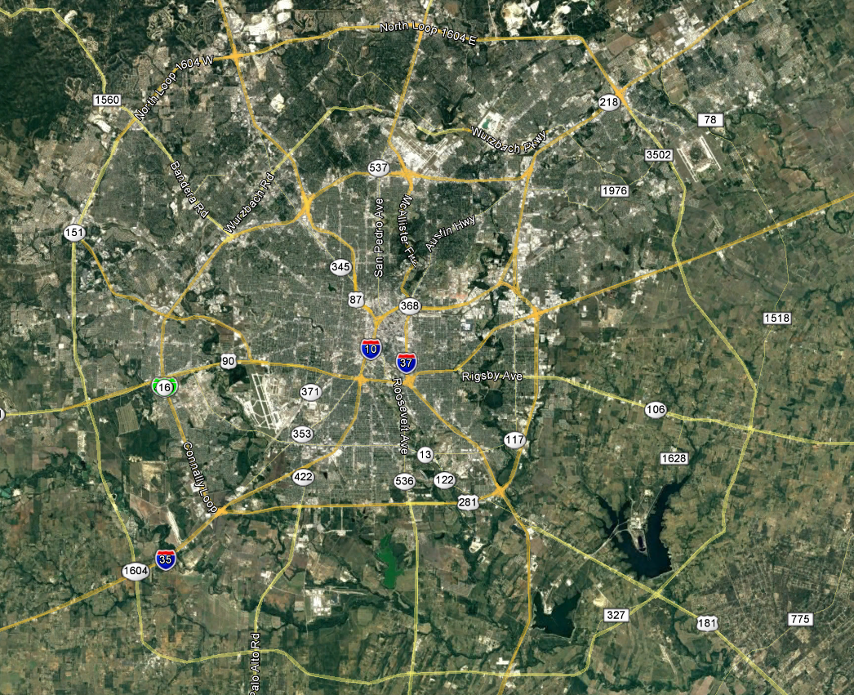
Project Location

Slide 38
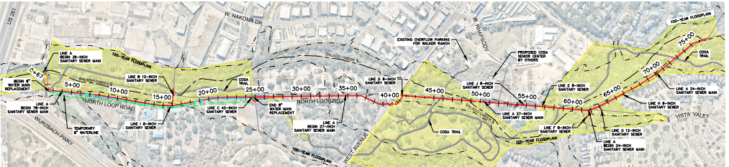
Project Alignment

Slide 39
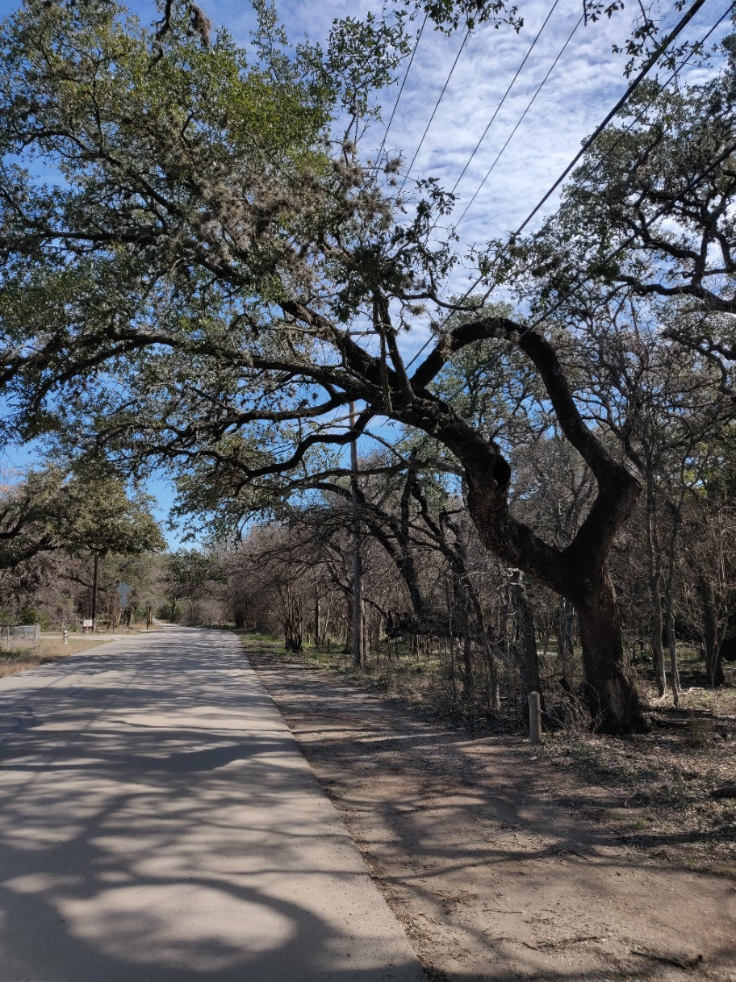
North Loop Road – Narrow ROW and Tree Impacts

Slide 40
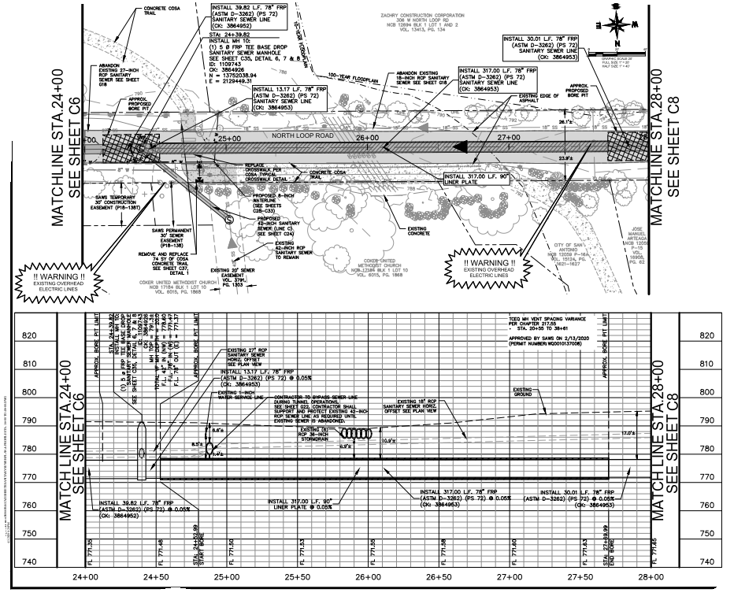
North Loop Road Creek Crossing
Tunneling under existing sewer main and Bypass

Slide 41
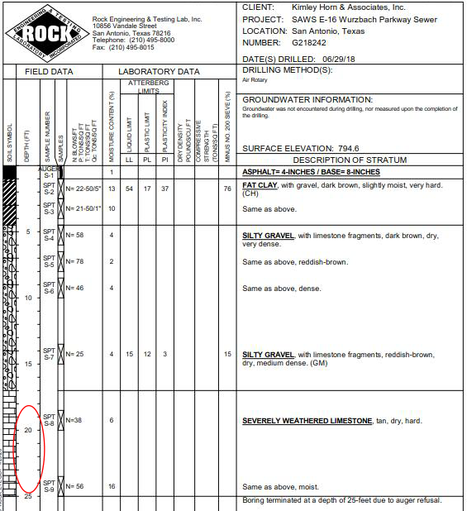
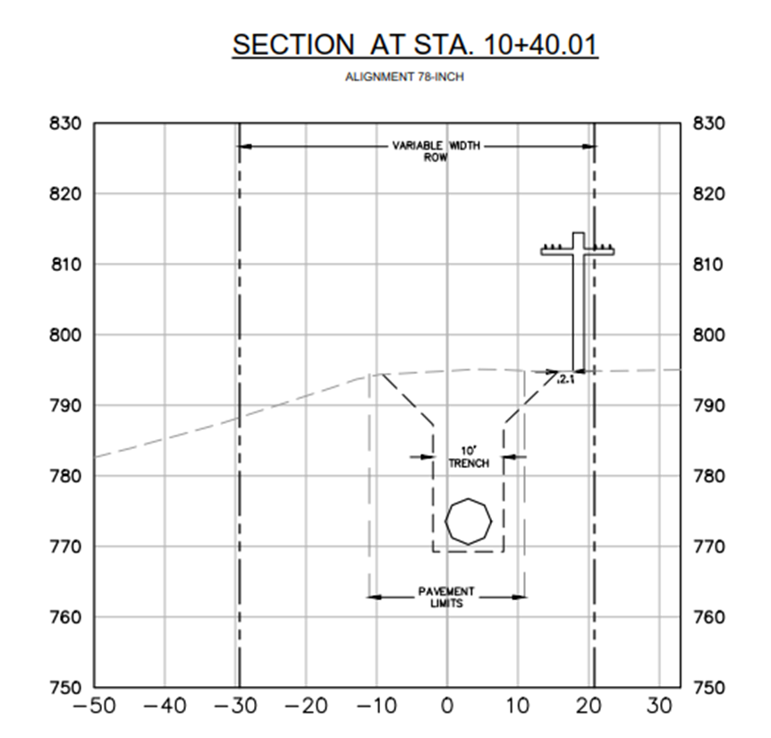
CPS Energy Allowance and Pole Bracing and Special Shoring

Slide 42
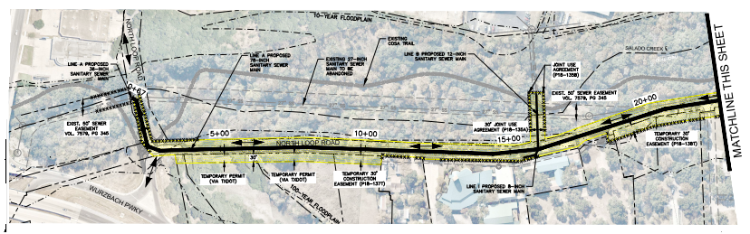
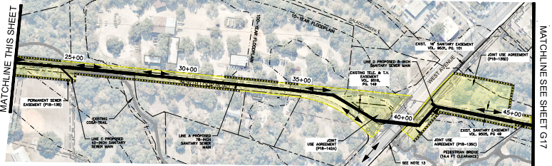
Construction Access – East of West Avenue

Slide 43
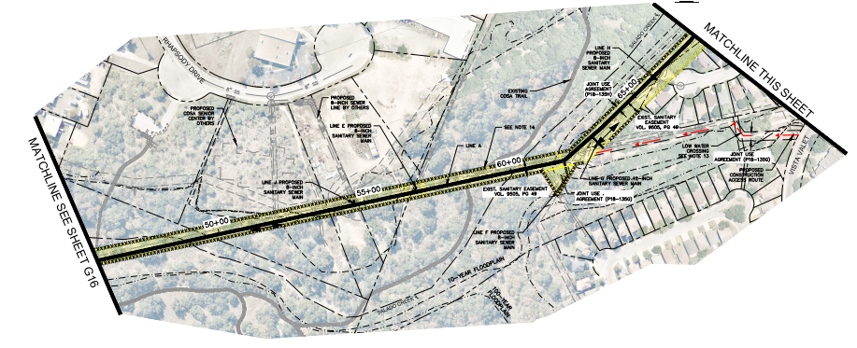
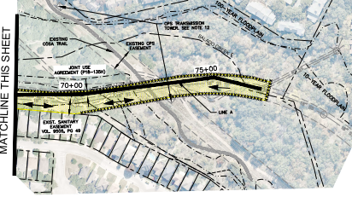
Construction Access – West of West Avenue

Slide 44
Stakeholders
East of West Avenue
West of West Avenue
CoSA Parks
Zachry Construction Corporation
Marguerite Ramsey
Jose Arteaga
Coker United Methodist Church
Coker Cemetery
Last Chance Forever
TxDOT
Barbara Bowman
CoSA Parks
CoSA TCI – Senior Center
Caspian Properties

Slide 45
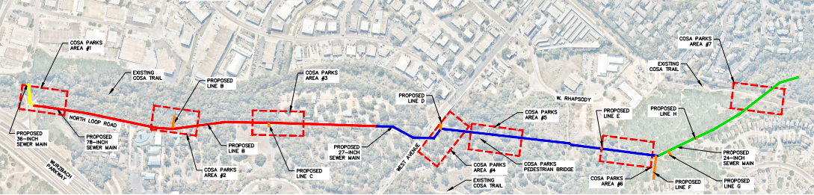
Special Conditions – CoSA Greenway Trail System Closure and Replacement

Slide 46
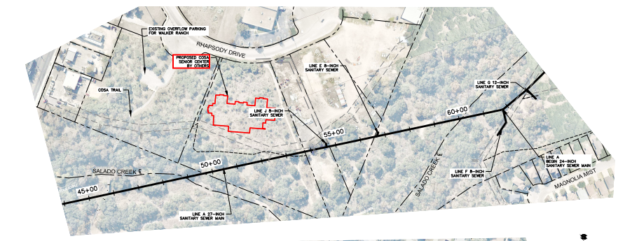
Special Conditions – CoSA Senior Center / Access

Slide 47
Additional Special Considerations
Contractor shall meet the requirements of the U.S. EPA Consent Decree
Geotechnical Report
CoSA Greenway Trail System Closure/Replacement
Archeological Monitoring
North Loop Road Trenching Requirements
CPS Energy Allowance and Pole Bracing/Special Shoring System
CPS Energy Easements
TxDOT Property
Coker United Methodist Church
Zachry Construction Corporation
CoSA Senior Center
Caspian Properties, LLC
Low Water Crossings
Native Seeding/Hydromulch
Coker Cemetery
Environmental Monitoring
Inlet and Outlet Structures

Slide 48
Permits
City of San Antonio Tree Permit
City of San Antonio Floodplain Development Permit
City of San Antonio Right-of-Way
Storm Water Pollution Prevention Plan (SWPPP)

Slide 49
Questions
Should be submitted no later than May 27, 2020 at 2:00 PM CDT
Identify solicitation number
Must be submitted in writing:
  Roxanne L. Lockhart
  Contract Administrator
  Contract Administration Department
  San Antonio Water System
  Roxanne.lockhart@saws.org
  Fax: (210) 233-4438

